Slide 1

Science Logic
Windows Server PP
Dynamic Apps
Raul Diez Canseco Christian Galarza

Slide 2

Overview
Architecture
Installation
Upgrade
Discovery Devices
Windows Server Power Pack
Dynamics Aplications

Slide 3
overview
Help us with monitoring different kind of devices
Bring us information about their functionality in real-time
All over in a web site

Slide 4
Architecture
All in One
Distributed
User Interface
Database
Data Collection
Message Collection
API

Slide 5
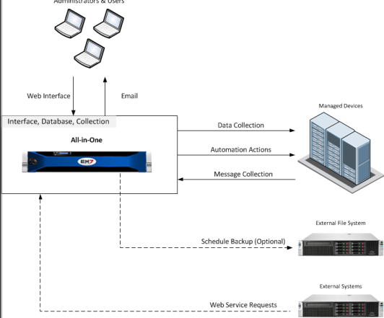
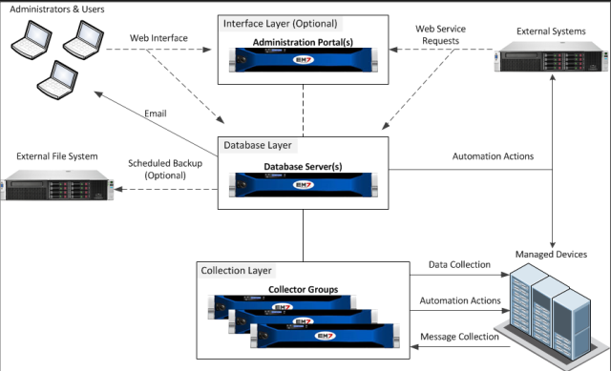
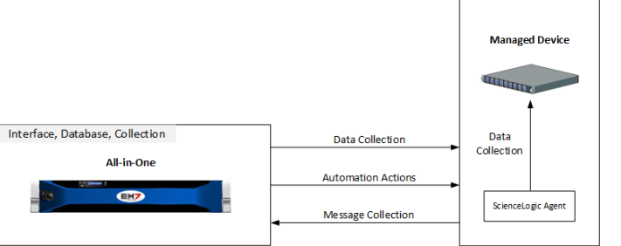
Architecture
All in One
Distributed
Agent

Slide 6
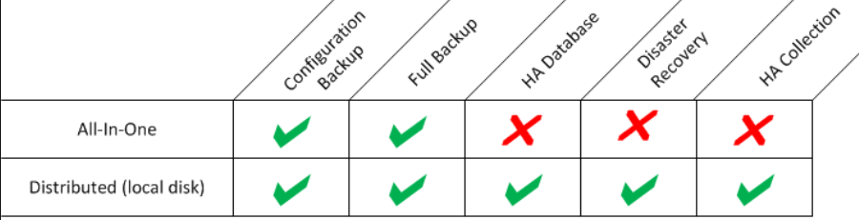
Backup, Recovery & High Availability Options
Configuration Backups
Full Backup
High Availability for Database
Disaster Recovery
High Availability for Data Collection

Slide 7
Installation
Hardware Requirements
Military Unique Deployment
More restricted use of credentials
 | RAM (GB) | CPU Cares | Disk (GB)
Database Servers | 6 | 2 | 80
Data Collectors | 4 | 2 | 60
Message Collectors | 6 | 2 | 60

Slide 8
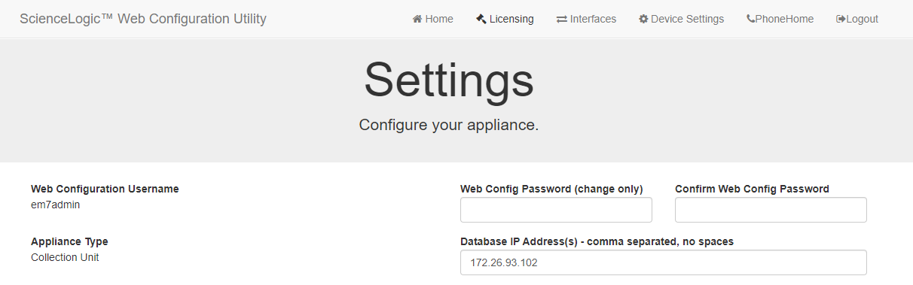
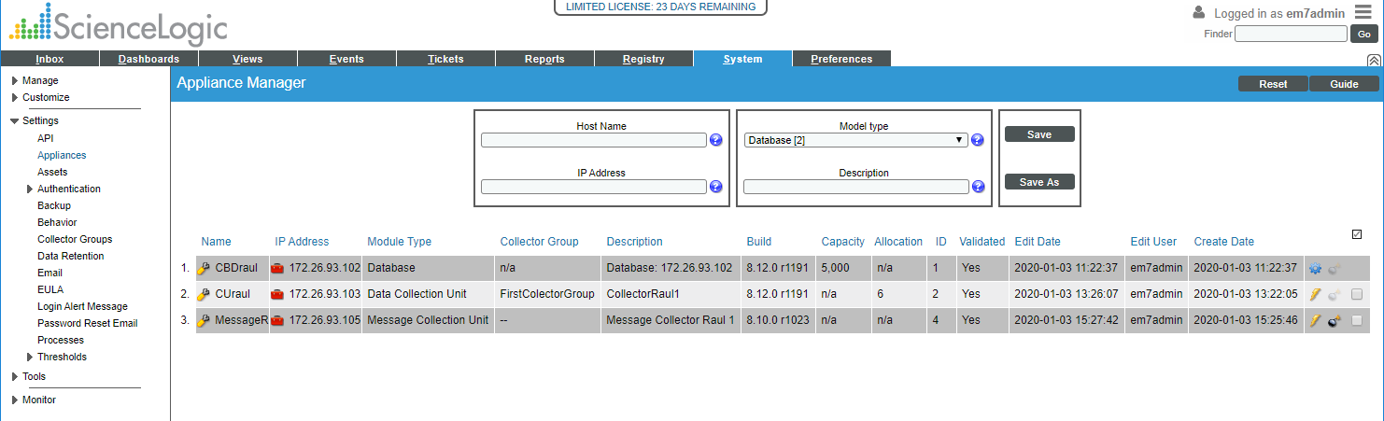
Configuration
Configure Distributed system
https://ip-address-of-appliance:7700
In SL1

Slide 9
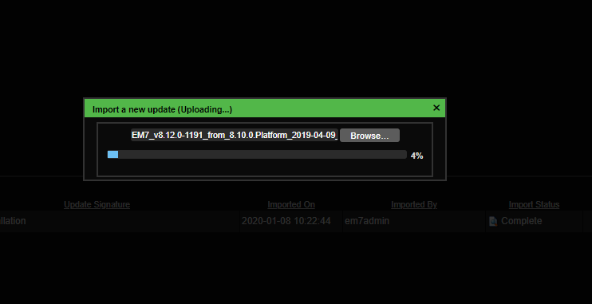
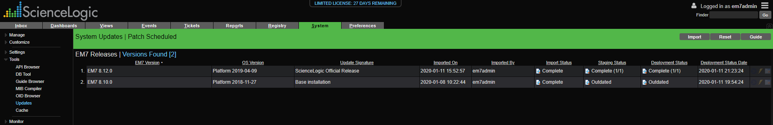
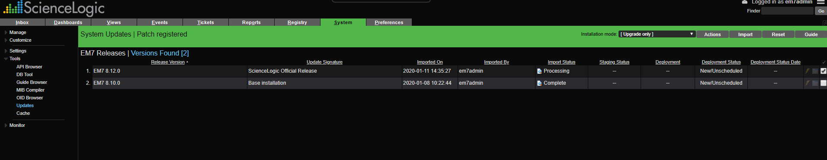
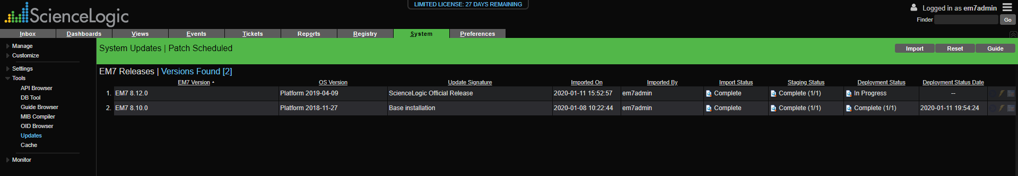
Upgrade

Slide 10
Discovery Devices

Slide 11
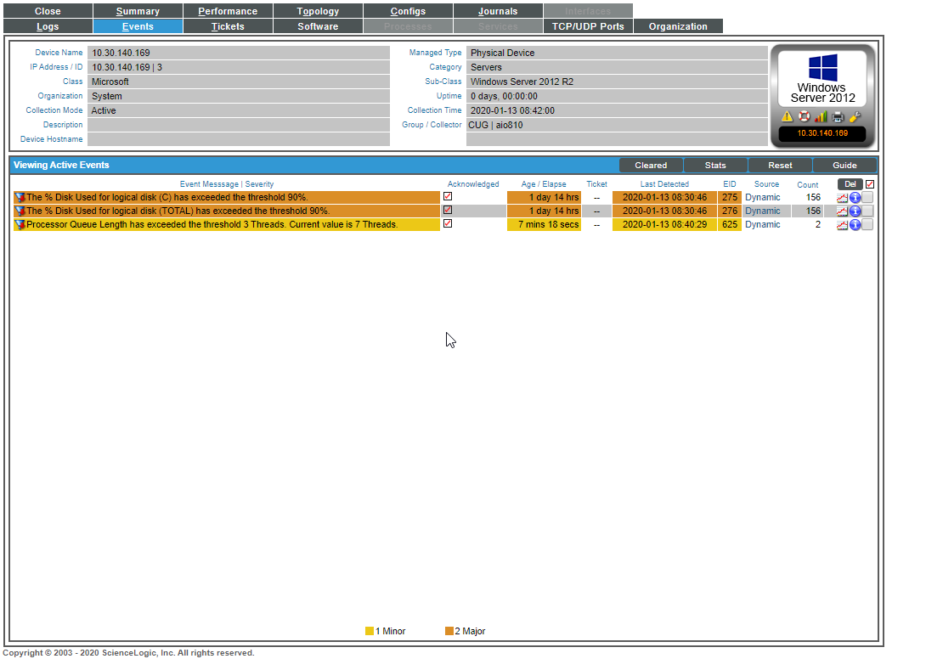
Events

Slide 12
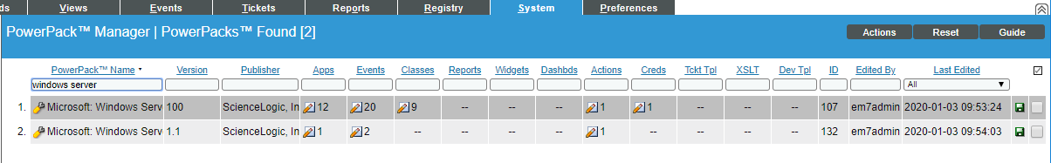
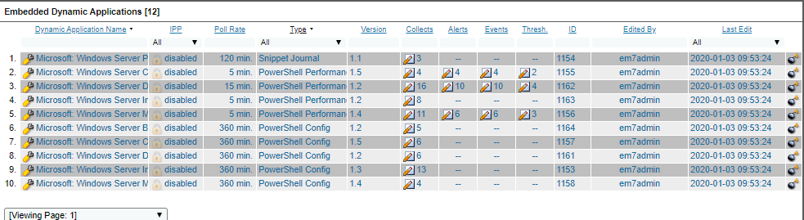
Windows Server Power Pack
Windows Server PowerPack

Slide 13
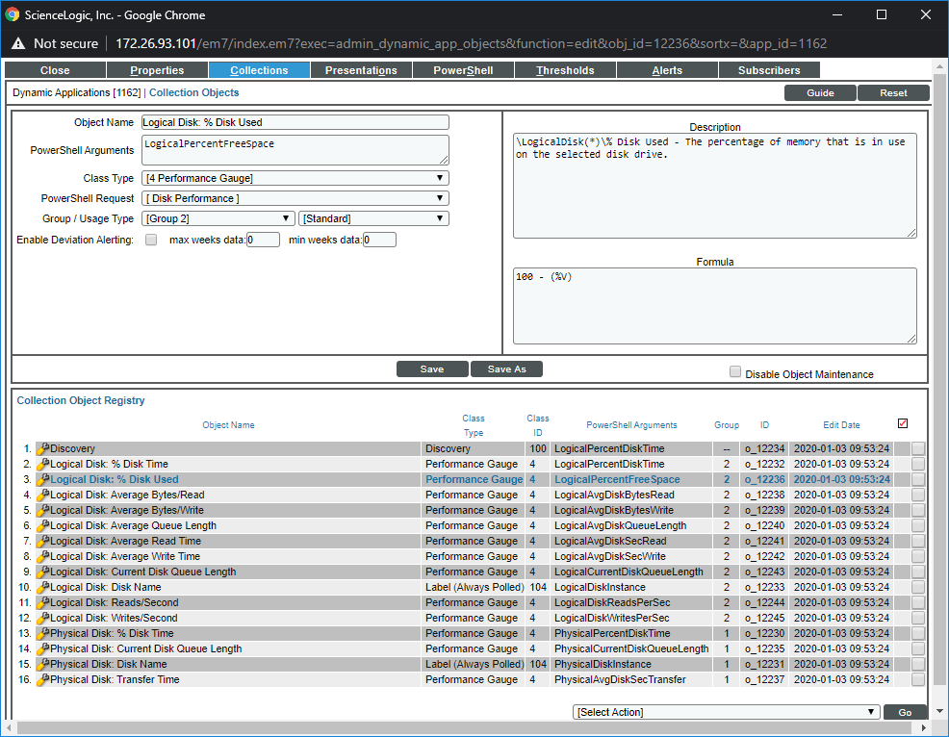
Collection objects

Slide 14
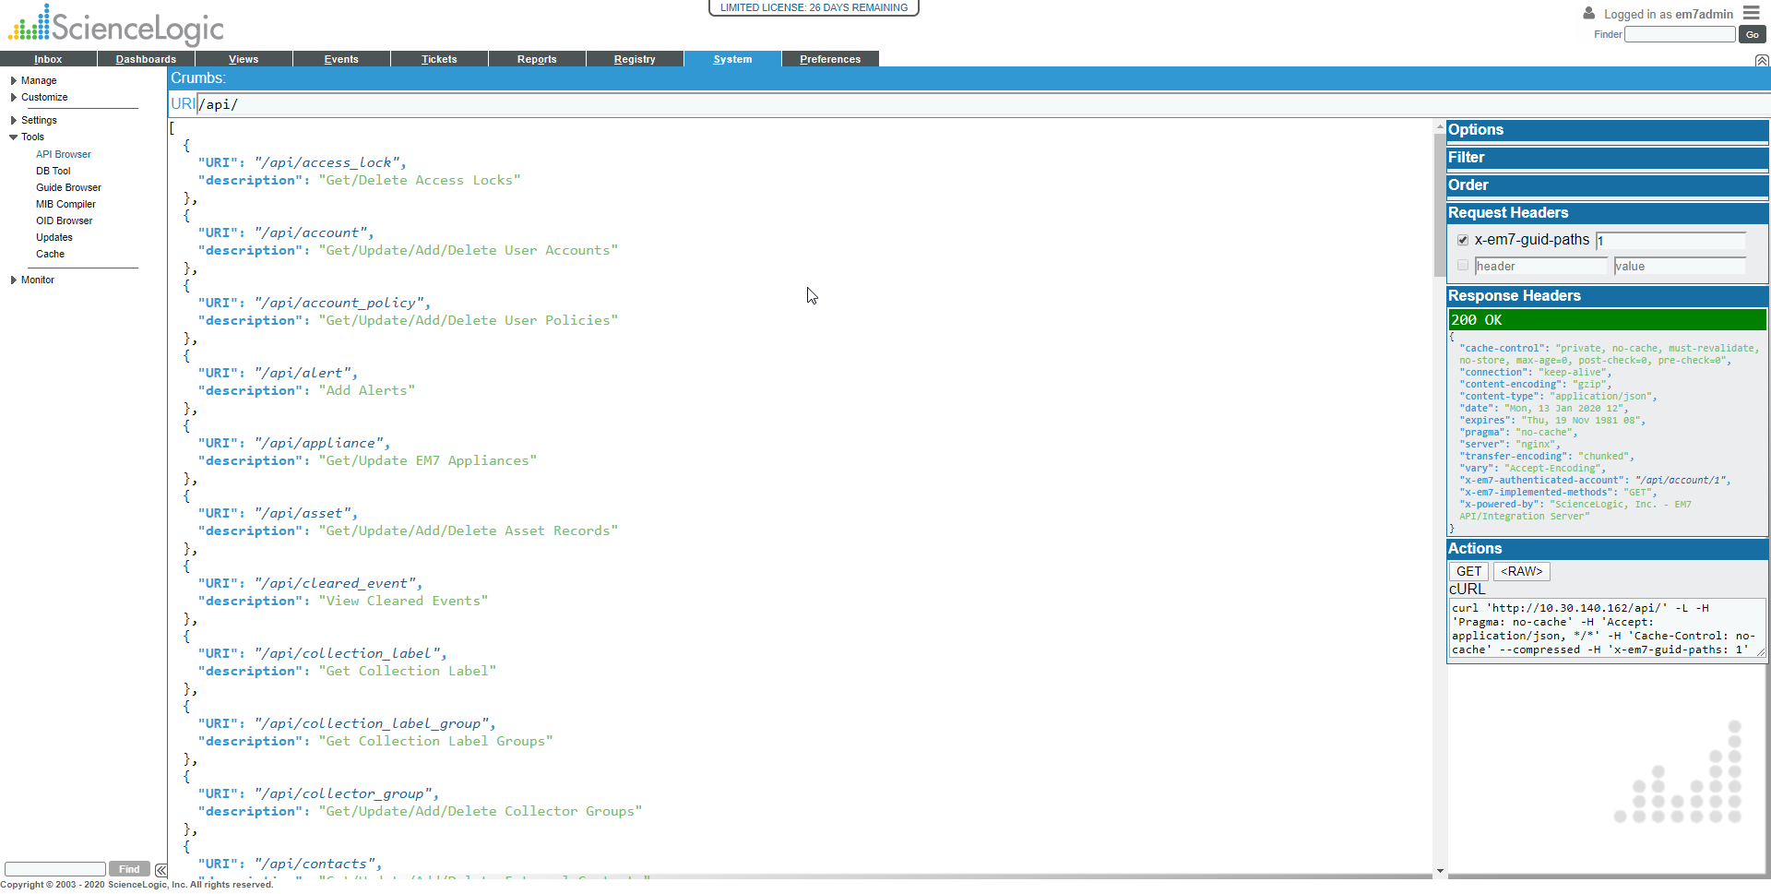
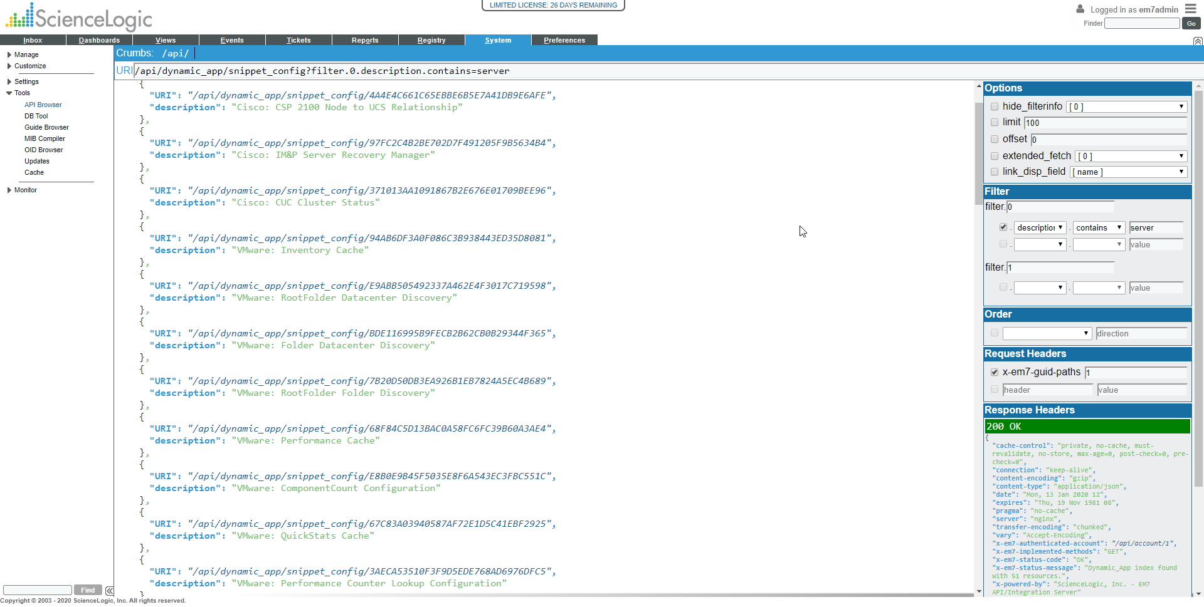
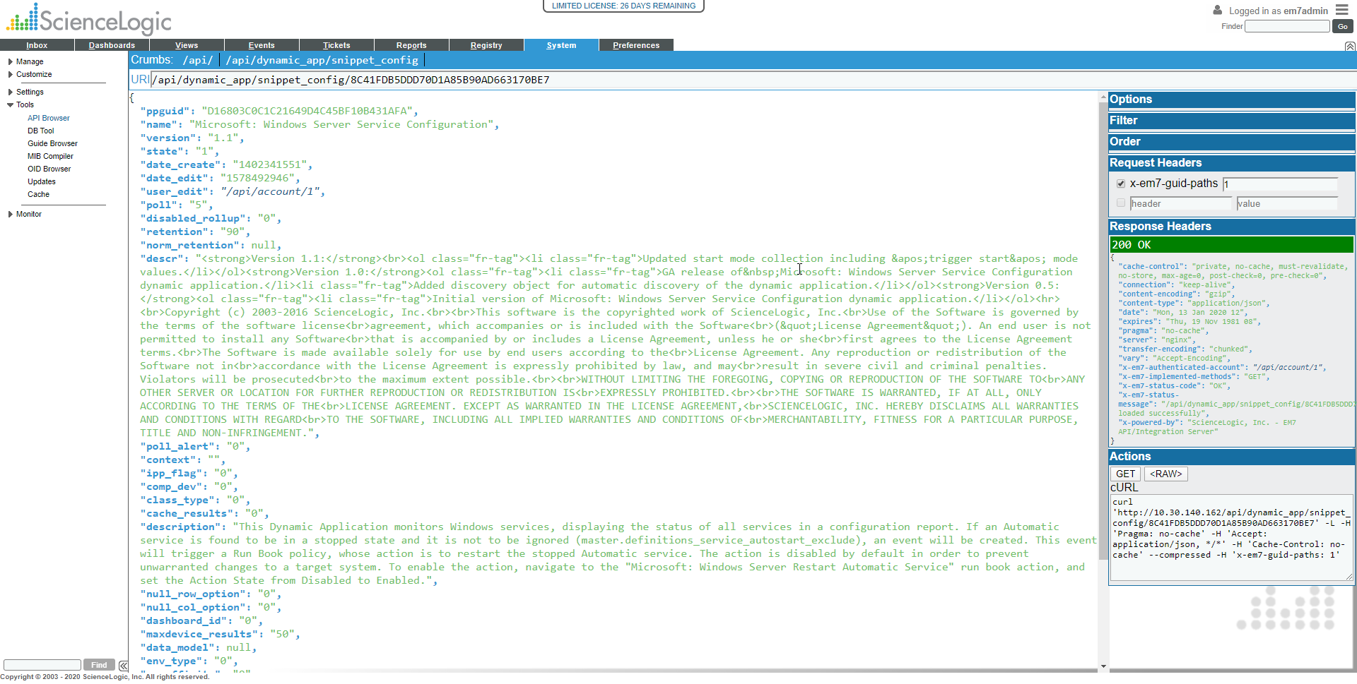
Snippels

Slide 15
Dynamics Applications
Archetypes
Windows Server Disk Performance (Performance)
Windows Server Service Configuration (Configuration)
Windows Server Process List (Journal)
Protocols
Bulk Snippet
Database
Internal Collection
PowerShell
Snippet
SNMP
SOAP
WMI
XML
XSLT

Slide 16
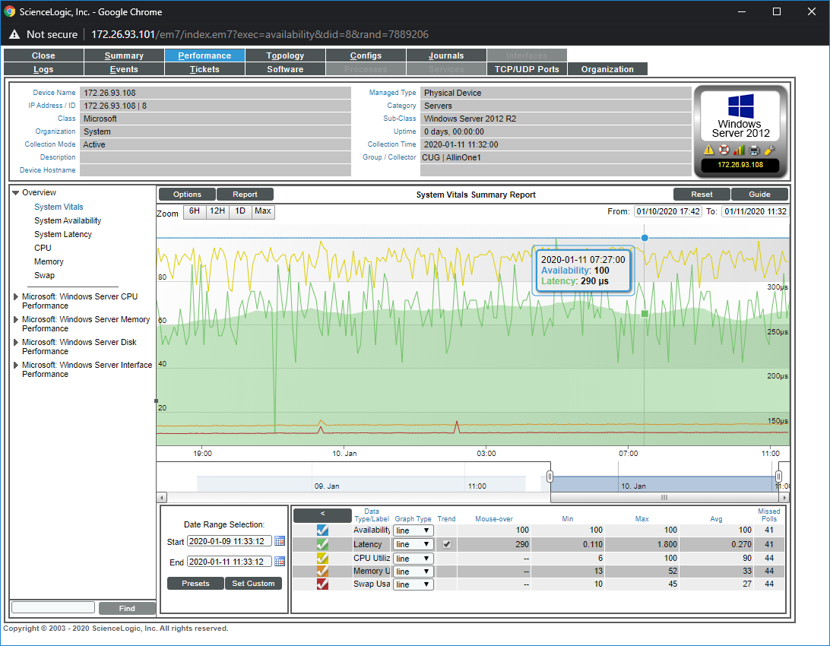
Dynamics Applications
Windows Server Disk Performance (Performance)

Slide 17
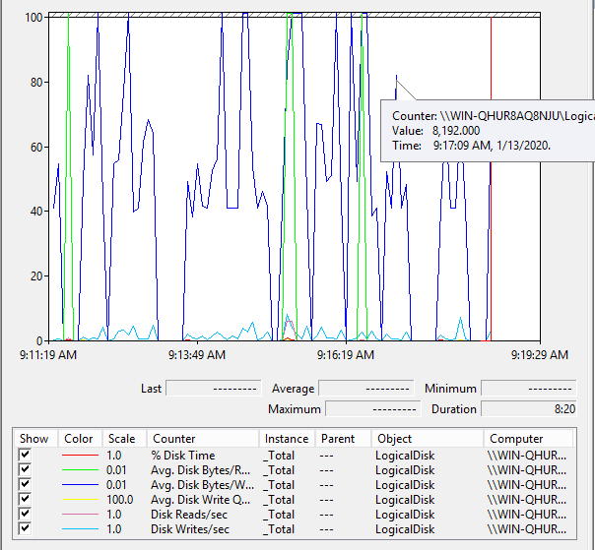
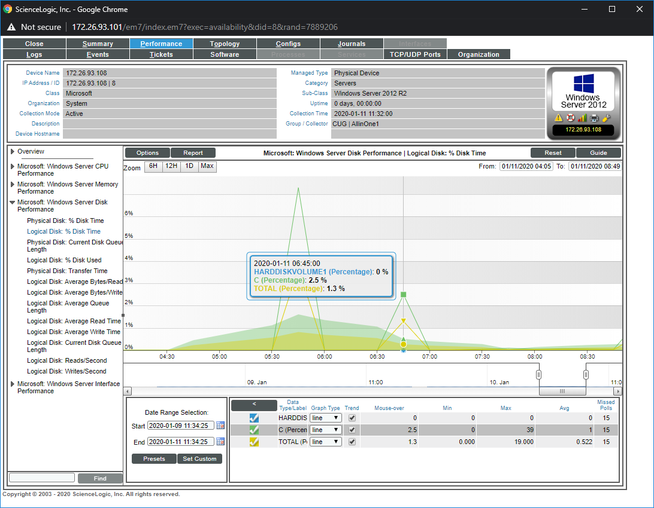

Slide 18
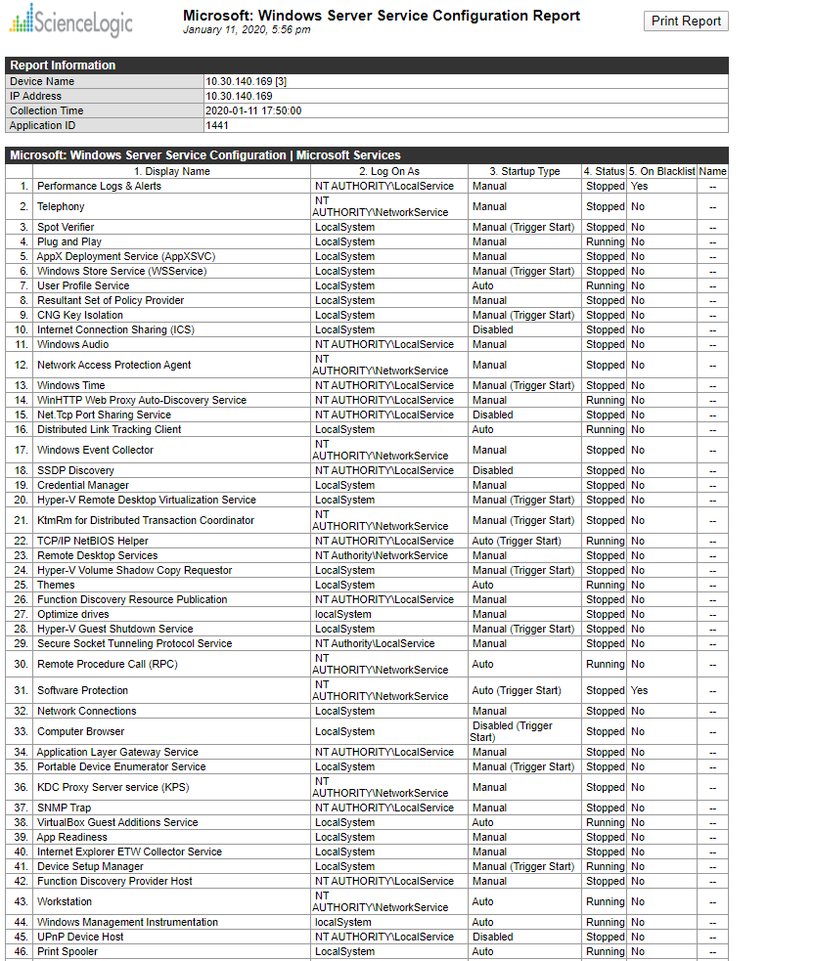
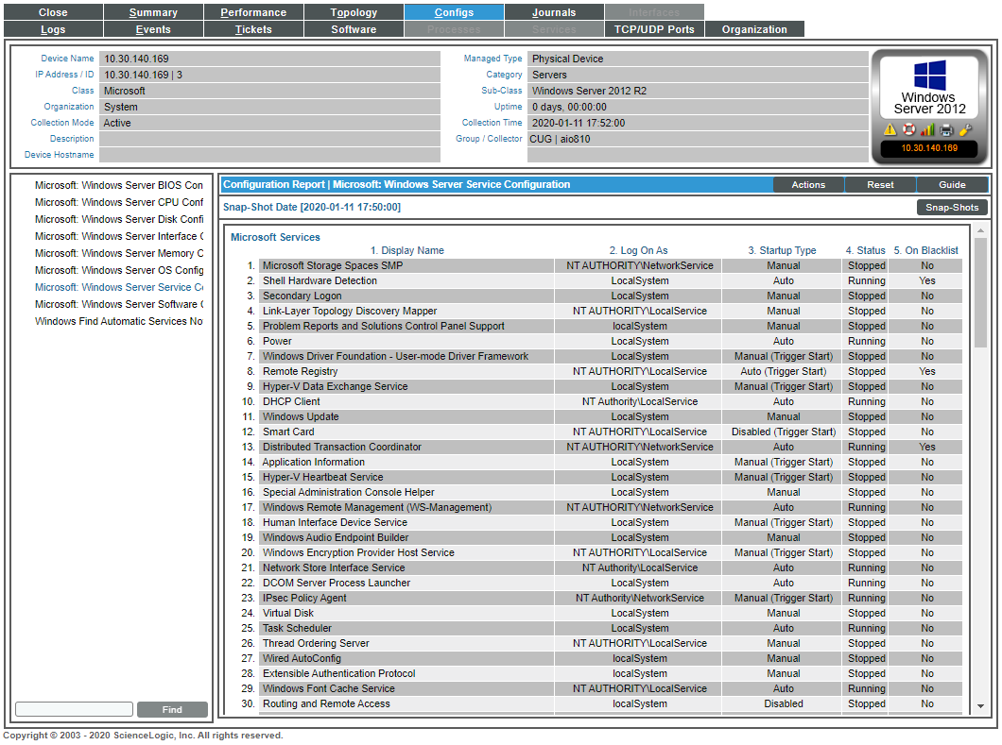
Windows Server Service Configuration (Configuration)

Slide 19
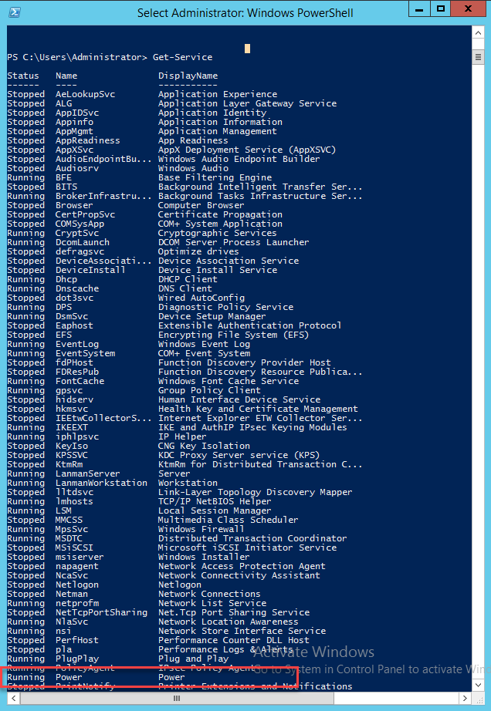
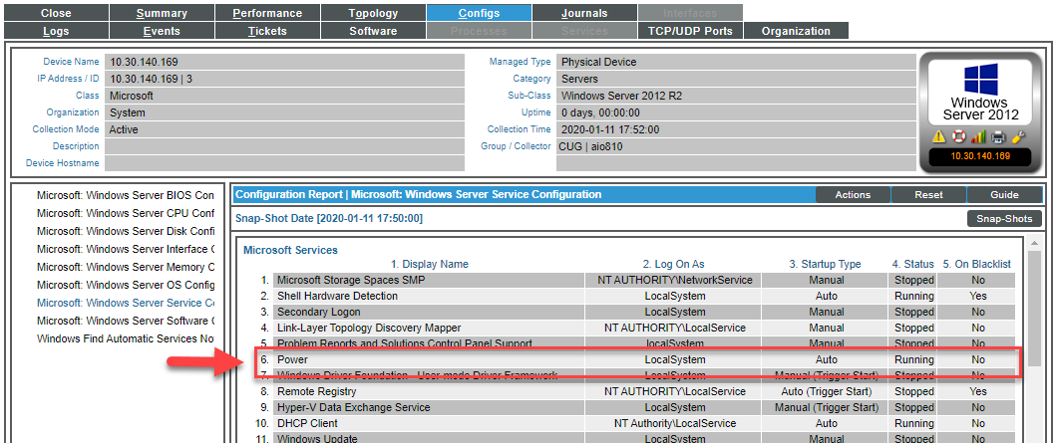
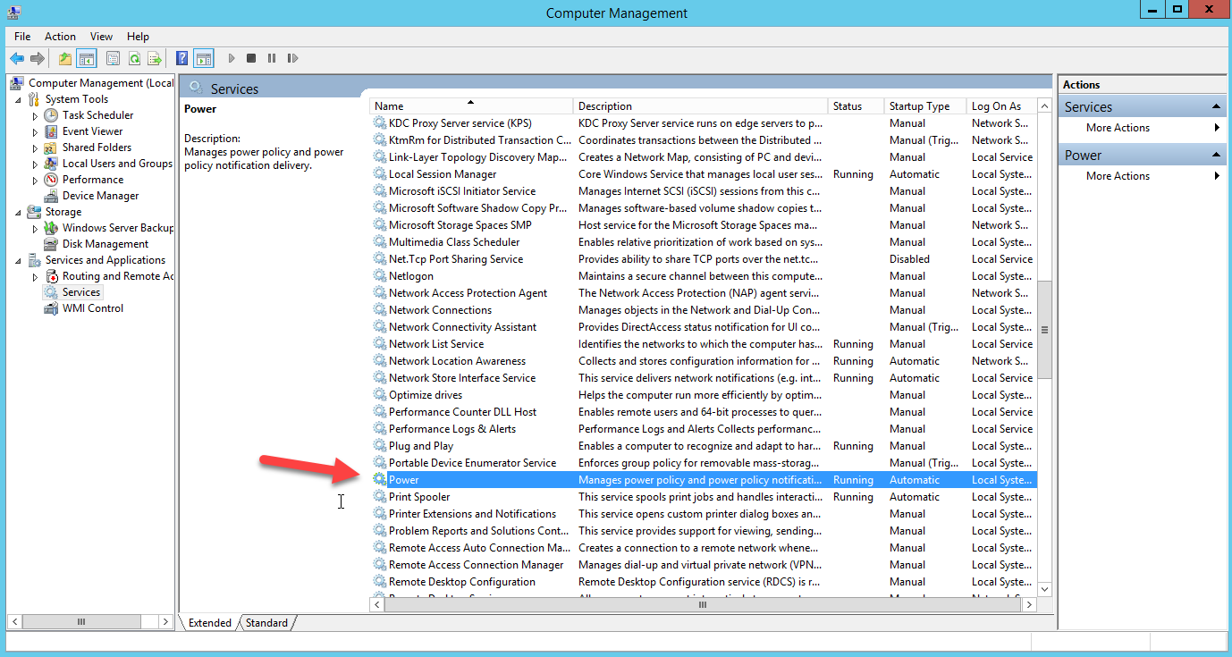
On SL1
On Computer Management WS

Slide 20
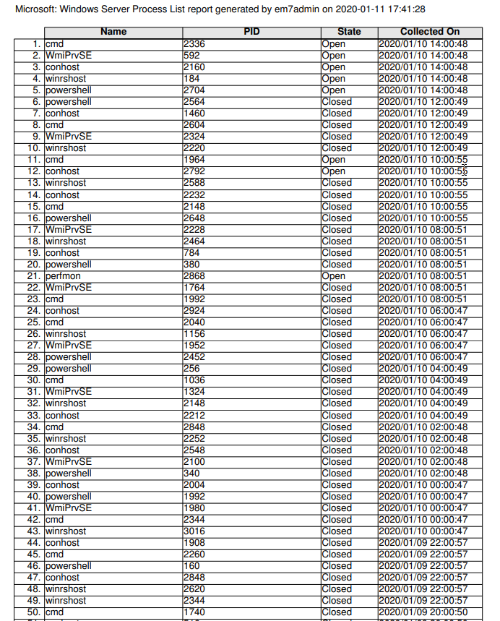
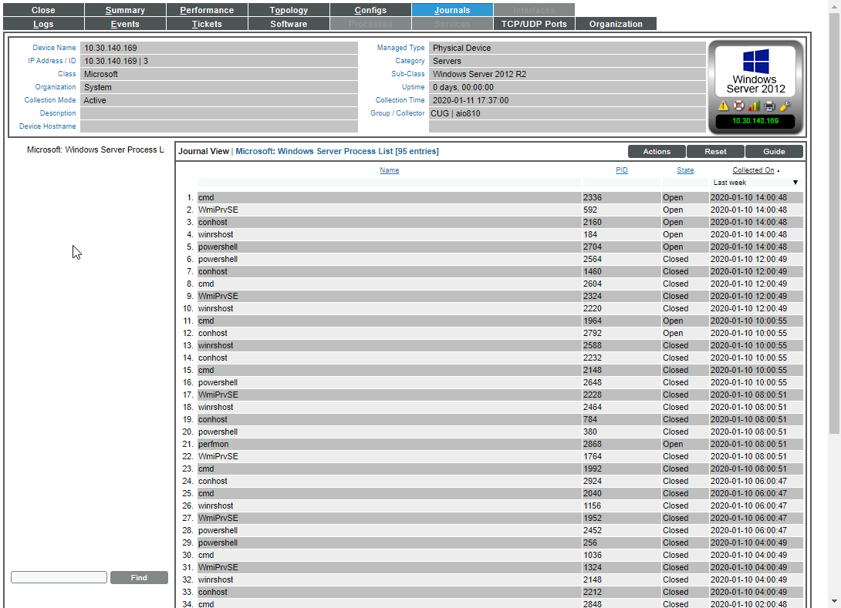
Windows Server Process List (Journal)

Slide 21
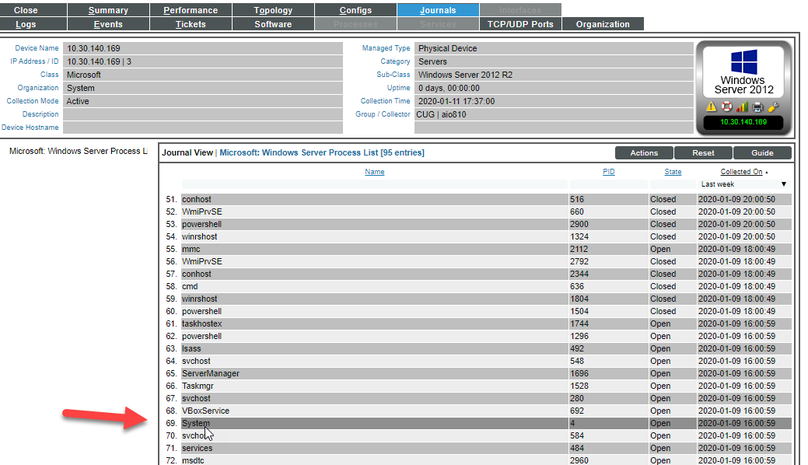
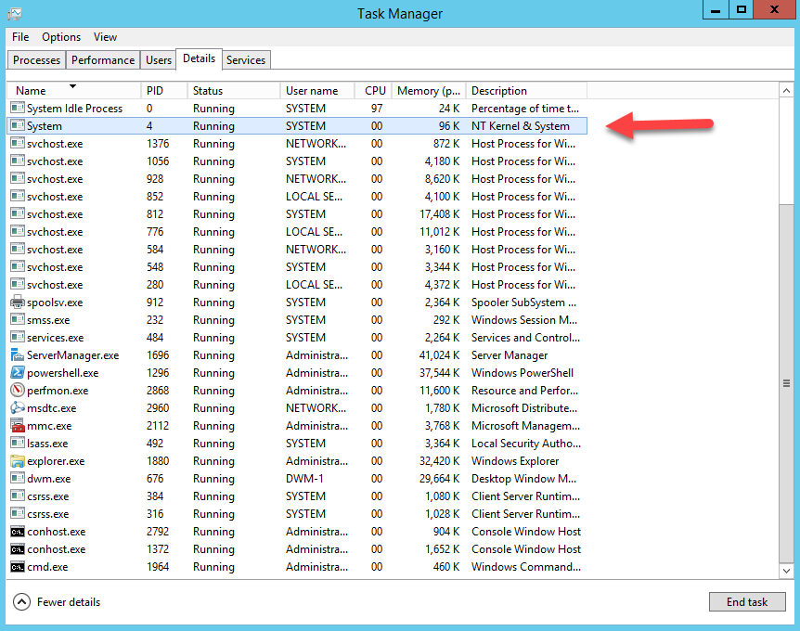
On SL1
On Task Manager WS

Slide 22


Slide 23


